Slide 1
Installing Ubuntu 12.04

Slide 2
The easiest way to put Ubuntu onto your stick is to use the USB installer provided at pendrivelinux.com.
You’ll need to download and install and follow the instructions.

Slide 3
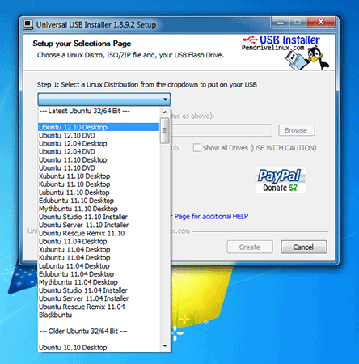
Select Ubuntu Desktop Edition from the dropdown list.

Slide 4
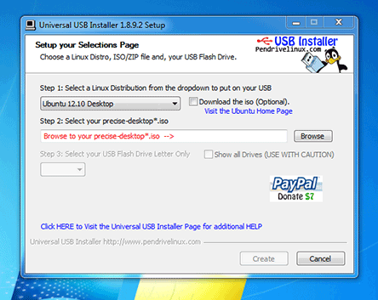
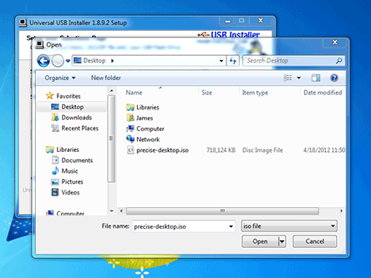
Click 'Browse' and open the downloaded ISO file.

Slide 5

Choose the USB drive and click 'Create'.

Slide 6
Most newer computers can boot from USB. You should see a welcome screen prompting you to choose your language and giving you the option to install Ubuntu or try it from the CD.
If your computer doesn’t automatically do so, you might need to press the F12 key to bring up the boot menu

Slide 7
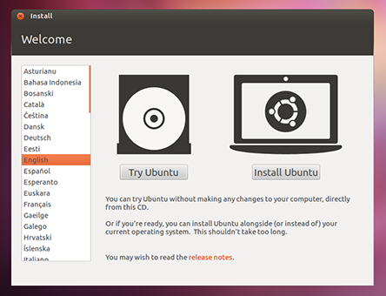
Welcome screen:

Slide 8
Prepare to install Ubuntu
plug your computer into a power source
You should also make sure you have enough space on your computer to install Ubuntu
Select Download updates while installing and Install this third-party software now
You should also stay connected to the internet so you can get the latest updates while you install Ubuntu

Slide 9
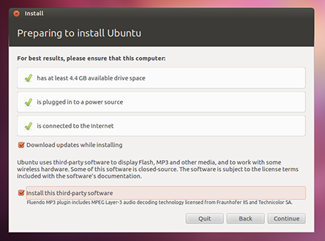

Slide 10
Allocate drive space
Use the checkboxes to choose whether you'd like to Install Ubuntu alongside another operating system, delete your existing operating system and replace it with Ubuntu, or — if you're an advanced user — choose the 'Something else'option

Slide 11
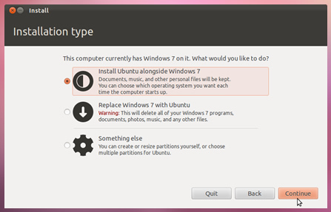

Slide 12
Begin the installation
Depending on your previous selections, you can now verify that you have chosen the way in which you would like to install Ubuntu. The installation process will begin when you click the Install Now button.
Ubuntu needs about 4.5 GB to install, so add a few extra GB to allow for your files.

Slide 13
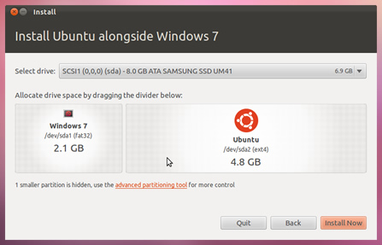

Slide 14
Select your location
If you are connected to the internet, this should be done automatically. Check your location is correct and click'Forward' to proceed. If you're unsure of your time zone, type the name of the town you're in or click on the map and we'll help you find it.

Slide 15
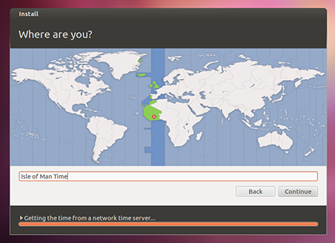

Slide 16
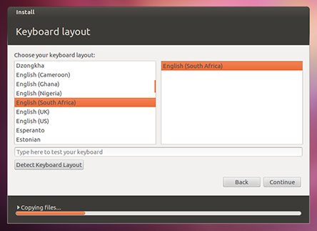
Select your preferred keyboard layout

Slide 17
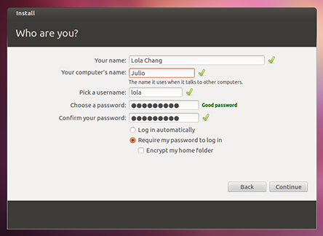
Enter your login and password details

Slide 18
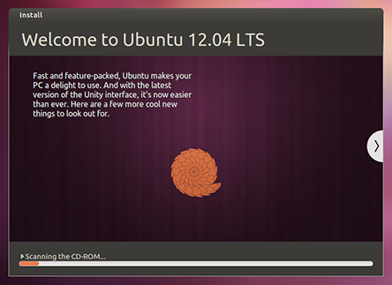
That’s It

Slide 19
Login Screen
After the installation is over and the computer is restarted, you will be greeted by the login screen of Ubuntu.

Slide 20
Unity
All GUI-based operating systems use a desktop environment. Desktop environments
encompass many things, such as:
  The look and feel of your system
  The way the desktop is laid out
  How the desktop is navigated by the user
In Linux distributions (such as Ubuntu), a number of desktop environments are available. Ubuntu uses Unity as the default desktop environment
This initial view is comprised of the e Desktop Background and two bars—one is horizontally located at the top of your desktop called the Menu Bar, and the other bar is vertically oriented at the far le, called the Launcher.

Slide 21
The Menu Bar
The menu bar incorporates common functions used in Ubuntu.
The icons on the far-right of the menu bar are called the indicator area. The most common indicators are (starting from the left)
Keyboard indicator allows you to select the keyboard layout you would like and change your keyboard preferences.
Messaging indicator incorporates all your social applications. From here, you can access your instant messenger client, your email client, your microblogging application, and even UbuntuOne, your personal cloud!
Network indicator allows you to manage your network connections and connect quickly and easily to a wired or wireless network.
Sound indicator provides an easy way to adjust the sound volume as well as access your music player and sound settings.
Clock displays the current time and provides an easy way to access your calendar and Time and Date settings.
User menu allows you to easily switch between different users and access your online and user accounts.
Session indicator provides an easy way to access System Settings, Updates, Printers, and session options for locking your computer, logging out of your session, restarting the computer, or shutting down completely.

Slide 22
The Launcher
The vertical bar of icons on the left side of the screen is called the Launcher.
The Launcher provides easy access to applications, mounted devices, and the Trash. All running applications on your system will place an icon in the Launcher while the application is running.
The first icon at the top of the Launcher is the Dash, a major innovation and core element of Unity

Slide 23
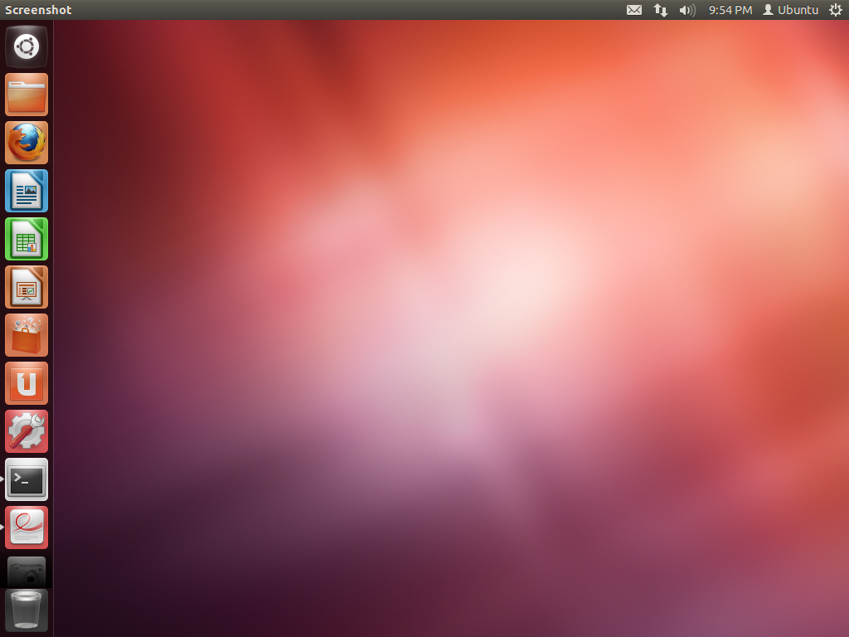

Slide 24
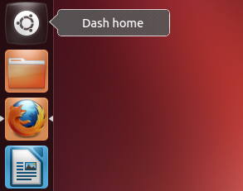
Running Applications
To run an application from the Launcher (or cause an already-running application to appear), just click on the application’s icon.
Running applications will have one or more triangles on the left side of its icon, indicating the number of application windows open for this application.
You can also run an application through the Dash.

Slide 25
The Dash
The Dash is a tool to help you access and find applications and files on your computer quickly.
If you are a Windows user, you’ll find the Dash to be a more advanced Start Menu.
If you are a Mac user, the Dash is similar to Launchpad in the dock.

Slide 26
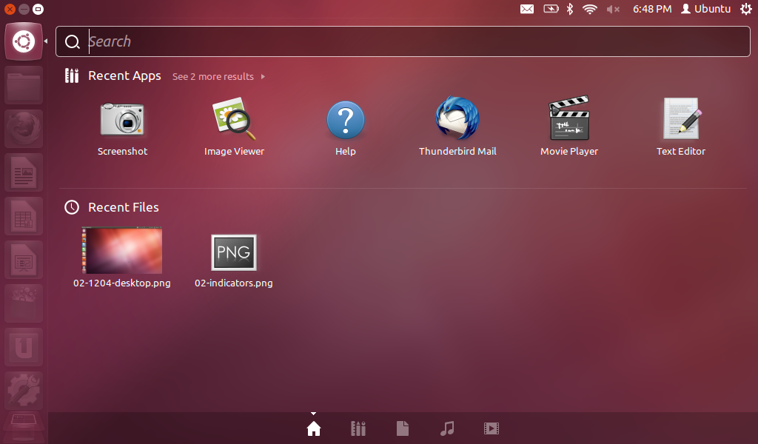

Slide 27

Workspaces
Workspaces are also known as virtual desktops.
These separate views of your desktop allow you to group applications together, and by doing so, help to reduce cluster and improve desktop navigation.
For example, in one workspace, you can open all of your media applications; your office suite in another, and your web browser open in a third workspace.
Ubuntu has four workspaces by default.

Slide 28
Software Center
There are numerous ways to install software on an operating system.
In Ubuntu, the quickest and easiest way to find and install new applications is through the Ubuntu Software Center.
The Ubuntu Software Center can be used to install applications that are available in the official Ubuntu repositories

Slide 29
Software Manager

